Slide 1
Front End Engineering-I Project
Team Details:DIKSHIT SINGLA (2210990284)
DIKSHANT SOHAL(22109990283)
DILJOT KAUR(2210990285)
DILPREET SINGH(2210990286)
Faculty Coordinator:DR.MONIKA SETHI
:
Chitkara University Institute of Engineering and Technology,
Chitkara University, Punjab

Slide 2
Table of Contents
Introduction
Problem Statement
Technical Details
Key Features
Project Highlights
Conclusion
References/Links used

Slide 3
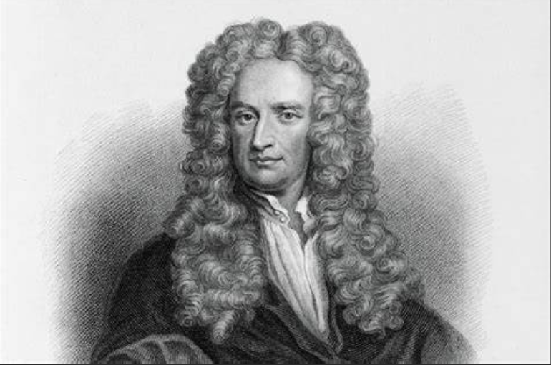
INTRODUCTION
A tribute page is a is a webpage dedicated in honor of someone you love, admire, or respect.
We wanted to honor one of the genius – “SIR ISSAC NEWTON”
Isaac Newton was the greatest English mathematician of his generation. He laid the foundation for differential and integral calculus. His work on optics and gravitation make him one of the
greatest scientists the world has known.

Slide 4
PROBLEM STATEMENT
Our goal was to develop and design a webpage to honor and admire someone as a tribute to them . Along with that we also wanted to create an informative webpage to inspire our readers with his speech, his actions, and by his work so that one can know about this person and motivate themselves through this person

Slide 5
TECHNICAL DETAILS
1.Background-image - Sets the background image of an element.
2.Background-repeat - Specifies how background images are tiled after they have been sized and positioned.
3.Background-size - Specifies the size of the background images.
4.Width - Specifies the width of the content area.
5. Height - Specifies the width of the content area.
6. Border - Shorthand property for setting border width, style, and color
7. Margin - Shorthand property to set values for the thickness of the margin area.
8. Position - Sets how an element is positioned in a document.
9. Float - Specifies how a box should be floated.
10. Display - In combination with float and position attributes, determines the type of box or boxes that are generated for an element.
11. Padding - Shorthand property to set values for the thickness of the padding area.
12. List-style-type - Used to construct the default contents of a list item’s marker.
13. Text-align - Describes how the inline contents of a block are horizontally aligned if the contents do not completely fill the line box.
14. Font-size - Indicates the desired height of text.
15. Color - Sets the color of an element’s text

Slide 6
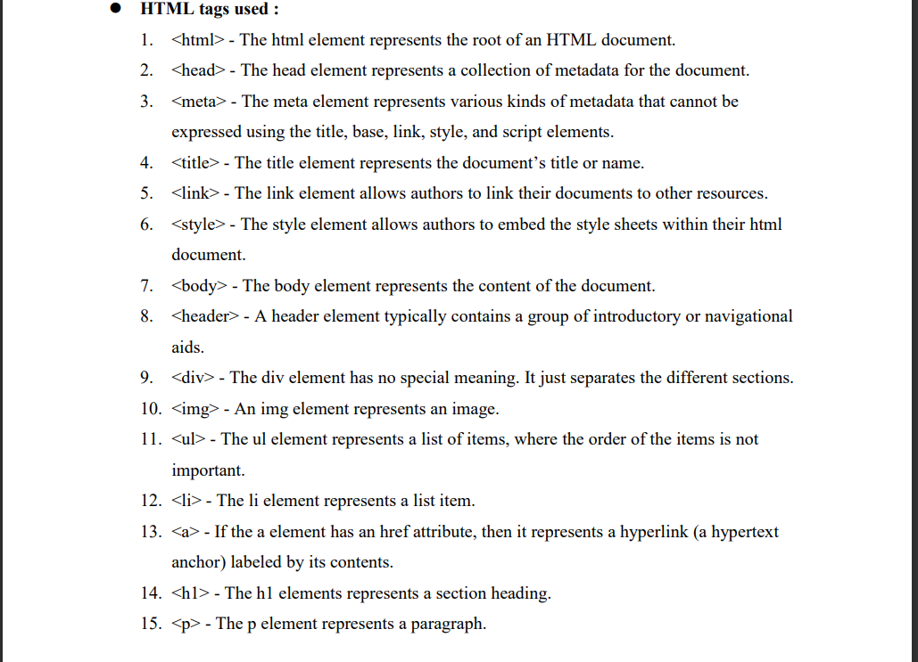

Slide 7
KEY FEATURES
Our Tribute page includes the following features :
Achievements.
2. Life Story - Professional and Personal.
3. Contributions.
4. More about the person.

Slide 8
PROJECT ADVANTAGES
We were successfully able to develop and design a webpage to honor and admire someone as a tribute to them.
Along with that we also created an informative webpage to inspire our readers with his speech, his actions, and by his work so that one can know about this person and motivate themselves through this person

Slide 9
CONCLUSION
This tribute page gives a brief information about the famous personalities their achievements etc. we have created an informative webpage to inspire our readers

Slide 10
REFERENCE/LINK USED
https://en.m.wikipedia.org/wiki/Isaac_Newton
https://www.britannica.com/biography/Isaac-Newton

Slide 11


